Slide 1
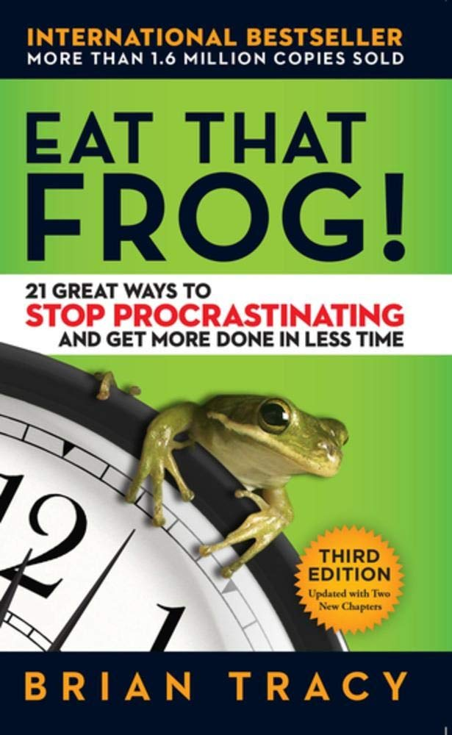
Your ‘frog’ is your biggest, most important task.
“The first rule of frog eating is this: If you have to eat two frogs, eat the ugliest one first.”
“The second rule of frog eating is this: If you have to eat a live frog at all, it doesn’t pay to sit and look at it for very long.”
“The key to reaching high levels of performance and productivity is to develop the lifelong habit of tackling your major task first thing each morning.”

Slide 2
1.Set the Table 2. Plan Each Day in Advance 3. Apply the 80/20 Rule to Everything 4. Consider the Consequences 5. Apply Creative Procrastination 6. Use the ABCDE Method 7. Focus On Key Result Areas 8. Apply The Law Of Three 9. Prepare Thoroughly Before You Begin 10. Take It One Step at a Time 11. Upgrade Your Key Skills 12. Leverage Your Special Talents 13. Identify Your Key Constraints 14. Apply Pressure On Yourself 15. Maximize Your Personal Powers 16. Motivate Yourself Into Action 17. Stop Technological Time Drain 18. Slice And Dice The Task 19. Create Large Chunks Of Time 20. Develop A Sense Of Urgency 21. Single-Handle Every Task

